Slide 1

Building GEM Student Research Capacity by Creating an Inclusive Learning Environment with Lego Serious Play
Gosia Plotka, Dr Dilshad Sarwar,
Dr Thaana Ghalia, Dr Patrice Seuwou

Slide 2



Agenda
Get to know each other
Present project aims, objectives and deliverables
Discuss evaluation and dissemination plan
Introduce the team and roles
Plan our work
Q&A

Slide 3
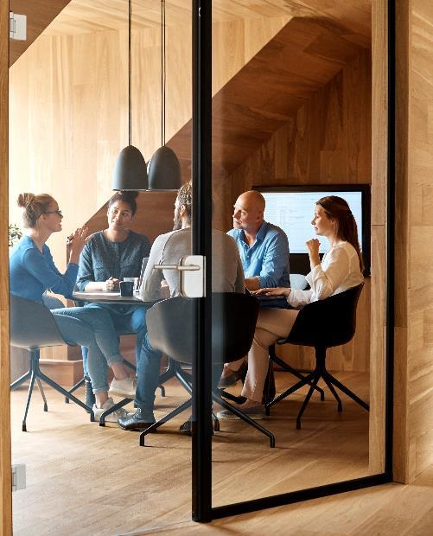



Introduction
LEGO® Serious Play (LSP) has impacted learning since it’s introduction within an educational setting since the 1990s. LSP has been successfully used to promote creative thinking and problem-solving; foster reflection, empathy and self-efficacy and develop shared understanding and goals. The aim of the study is to expand on existing research in playful approaches and building students' confidence via imaginative, multisensory learning. As a team we have experience in delivering session to variety and diverse audience, conduction the research and running projects using creative methods including LSP. Through this project we expect to shape sustainability teaching frameworks which will improve the learning and teaching experience of our stakeholders; students and staff.

Slide 4

Intended benefit and impact
Through this project, we would like to explore the possibility of building in Universal Design for Learning (or as it is called at UoN inclusivity by design) into the curriculum and make use of promoted by NTRM network non-traditional research methods. Our focus is on creating synergy between research capacities and teaching.
In particular, we plan to concentrate on our PG students’ research capabilities such as critical aspects of project management and leadership styles. Therefore, we plan to take advantage of Lego Serious Play’s® inclusive and democratic character to help our students learn how to share, discuss, and synthesise their ideas as it takes place in design thinking style research. Using Lego® bricks, as cognitive artifacts (or mediators) to collect their data, students may, literally, give their thoughts colour and shape which will make it easier to see them and ask questions around them.

Slide 5
Project aims & objectives
Aims
Objectives
To enhance students’ educational experience
To introduce participatory research methods with the use of Lego as a data collection tool
To contribute to the university's Changemaker mission by expanding on existing research avenues through developments in pedagogic theory and practice
To further increase the profile of the University of Northampton (UoN) as a university supporting the diversity of learning needs
To build departmental KTP capability through engaging with businesses at local and national levels
To diversify current approaches to research by addressing different learning styles and nerds
To implement the systematic introduction of playful learning into the university curriculum
To develop an approach to bridge the gender gap in the STEM fields and to increase active participation by other minority groups that currently are under-represented
Notes:
Preliminary exploration of suitable LSP techniques for immediate application on a controlled basis; this to take place, as practicable, during the process of assessing the overall picture of the results and outcomes of the experimental sessions undertaken.
Through this project we aim to explore the potentials of creative methods for supporting the teaching and learning experiences of Global Ethnic Minority (GEM) students with a view to ensuring that teaching and learning experiences are delivered on an equitable basis for all our students.

Slide 6
Project outputs and deliverables
The output of this project is going to be a new teaching process mapped and formalised with the use of the Business Process Model and Notation (BPMN, business process modelling standard). As a result of this process, our students will be not only able confidently use needed by change agents and changemakers' participatory research methods but also build on their reflective and critical thinking abilities - skills demanded by the current job market (Rios et al., 2020).
Rios, J.A., Ling, G., Pugh, R., Becker, D. and Bacall, A., (2020). Identifying critical 21st-century skills for workplace success: A content analysis of job advertisements. Educational Researcher, 49(2), pp.80-89

Slide 7
Dissemination Plan
Delivering designated workshops at the UoN annual Learning and Teaching Conference 2022 where the team would re-enact selected procedures for discussion and critique.
Delivering to a wider student audience the experimental sessions that have already been assessed for effectivity. In this way, students would have the opportunities for discussion and critique similar to those that were made available to staff and stakeholders at the aforesaid conference.
Dissemination of research findings through LTA and RAISE/FACE Conference and publishing article(s) in education journal(s) (e.g., WPLL)
Delivering workshops in line with and integrated into the Faculty Staff Development, LLS and C@N-DO calendars.

Slide 8
Evaluation
This research study will be evaluated through the successful achievement of the core objectives Even though we are going to ensure a diverse representation of students for both, the workshop, and data collection to avoid the deficit model, the feedback from the GEM students as the core stakeholders as well as staff and partners will also be imperative for the evaluation of this study. Feedback from other students will be also used.
The fundamental aspects of this study are to create an inclusive learning environment for GEM students and to ensure that there is equity and equality embedded within the learning and teaching curriculum. The findings of this study will also play a key influencing factor on addressing the current inequalities which are preventing GEM students from achieving their full potential. Furthermore, the study will be measured against the success of the stakeholder engagement with this method of learning and teaching in view of enhancing GEM student experiences in alignment to retention and engagement within the teaching environment.

Slide 9
Team
Gosia
Dilshad
Thaana
Patrice
Momina
Idris

Slide 10
Workplan
 | April | May | June | July
Run consultation meeting with stakeholders
Design, produce and distribute project posters and flyers
Design, develop research approach and identify participants
Submit ethics application at UoN
Plan workshop with students, staff and business
Conduct recorded activities with Lego
Collect all research and analysing findings
Run project Dissemination Workshop
Present of the findings at the Learning and Teaching conference
Update project site
Complete end of project report

Slide 11
Timeline
The self-familiarisation process with relevant LSP techniques
May
Submit ethics application at UoN
June
Run consultation meeting with stakeholders | Design, develop research approach and identify participants & Plan workshop with students, staff and business
Mid-July
End of July
Complete end of project report
Conduct recorded activities with Lego & Collect and analyse data

Slide 12

Summary
Once we successfully complete the project, others can implement this approach to enhance the experience of home students with a diversity of learning needs or address better different cognitive abilities of everyone who comes to study with us

Slide 13


Thank You

