Slide 1
Protesting the Machine:
Cut up Poetry Workshop
Dr Sam Kemp and Dr Sam Waterman
7/11/24

Slide 2

Today
Welcome! And brief Introductions
10 minute mini-lecture on The Luddites + Lord Byron’s Song for the Luddites
10 minute discussion on Richard Brautigan’s All Watched Over by Machines of Loving Grace (1967)
5 minute Chat GPT Poetry writing exercise
Break and online/in room group split
Cut Up Poem Workshop [in-room]
Erasure Poem Workshop [online]
10 minute Sharing [all together]

Slide 3

Introductions
What machine/technology makes you angry?

Slide 4
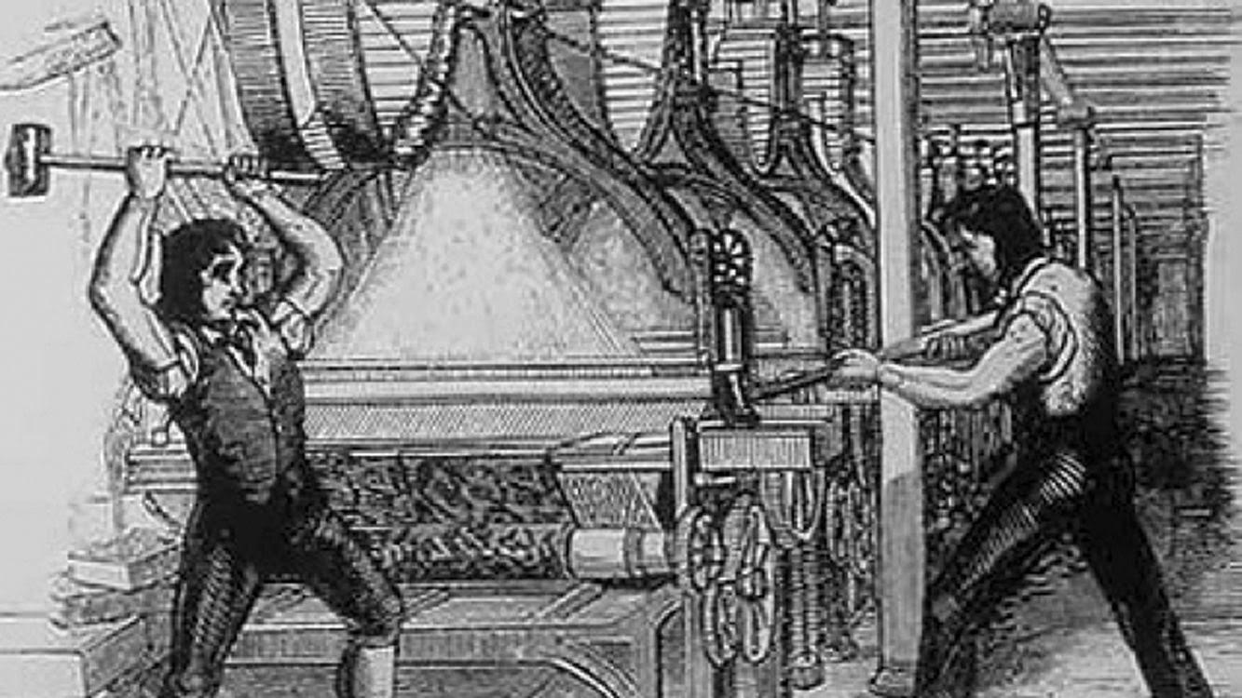
The Luddites
What is a luddite?
Early C19 followers of General/King Ludd
Context: Industrial Revolution and The Power Loom (could do the job of 6 men)
Community/union of weavers, croppers and other sympathetic trades
1812 Height of the Movement: ‘The mill owners were in fear for their machines, and would rather any night pay than fight. And for the great mass of the people, those who had to work for their living, they believed in General Ludd. In some way they could not fathom nor explain the Luddites were to bring back the good times, to mend trade, to stock the cupboard, to brighten the grate, to put warm clothes on the poor shivering little children’.
Rawfolds defeat and Government response
This Photo by Unknown Author is licensed under CC BY
“Ben o’ Bill’s, THE LUDDITE: A Yorkshire Tale. By D. f. e. Sykes, LL.B.” [n.d.]. Gutenberg.org <https://www.gutenberg.org/files/54030/54030-h/54030-h.htm> [accessed 4 November 2024]

Slide 5
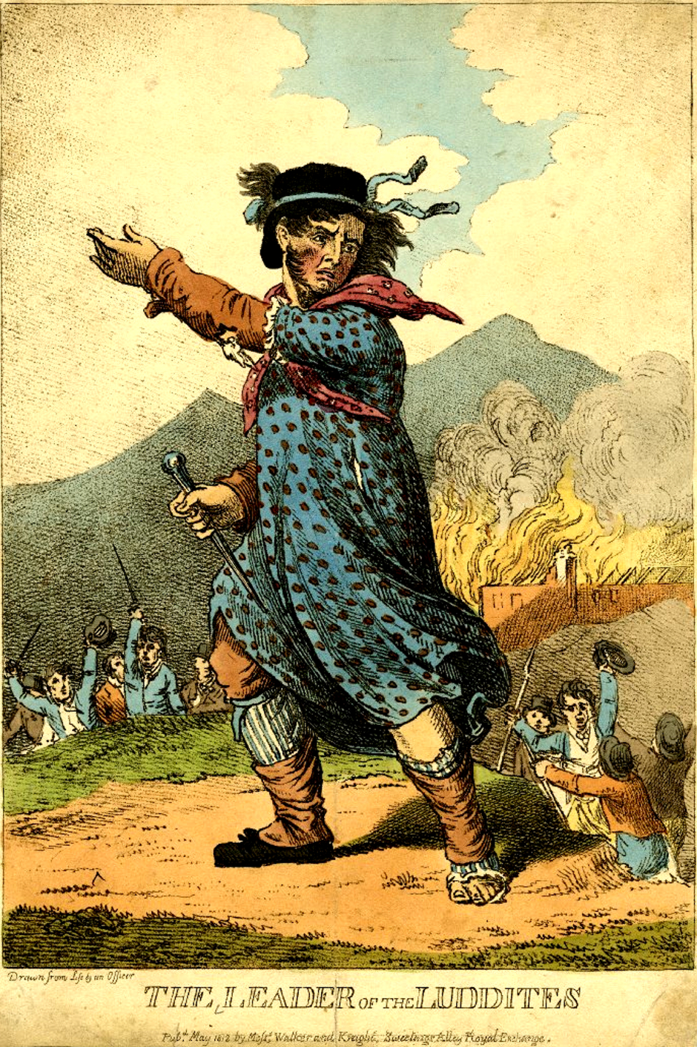
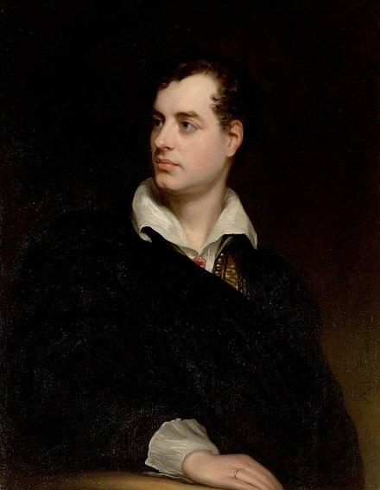
The Literary Luddites
Touchstone of protest, then and now
C19 poems and songs (including mid C19 Chartist movement)
C19 Letters written to mill owners and key figures
General Ludd as a modern day Robin Hood = adaptable ghost
Popular advocate in Lord Byron (rousing 1812 Maiden House of Lords Speech)
Byron anonymously wrote and published ‘An Ode to the Framers of the Frame Bill’ in 1812
This Photo by Unknown Author is licensed under CC BY
This Photo by Unknown Author is licensed under CC BY-SA

Slide 6
Song For The Luddites (1816) by Lord Byron
I.
As the Liberty lads o’er the sea
Bought their freedom, and cheaply, with blood,
So we, boys, we
Will die fighting, or live free,
And down with all kings but King Ludd!
II.
When the web that we weave is complete,
And the shuttle exchanged for the sword,
We will fling the winding sheet
O’er the despot at our feet,
And dye it deep in the gore he has pour’d.
III.
Though black as his heart its hue,
Since his veins are corrupted to mud,
Yet this is the dew
Which the tree shall renew
Of Liberty, planted by Ludd!
Not published until 1830
Repeated ‘we’ – collectivity
Ludd as mythic figurehead
Planting of seed of technological dissent

Slide 7
All Watched Over by Machines of Loving Grace (1967) By Richard Brautigan
I like to think (and the sooner the better!) of a cybernetic meadow where mammals and computers live together in mutually programming harmony like pure water touching clear sky.
I like to think
(right now, please!) of a cybernetic forest filled with pines and electronics where deer stroll peacefully past computers as if they were flowers with spinning blossoms.
I like to think
(it has to be!)
of a cybernetic ecology
where we are free of our labors
and joined back to nature,
returned to our mammal
brothers and sisters,
and all watched over
by machines of loving grace.
Write two sentences:
What is the poem about?
How does it achieve that effect?
Utopian vision = Ludd’s seed sprouted?
Sensory descriptions/images
Juxtaposition of machine and person = collectivity
Repetition and pattern

Slide 8


Chatting with AI
‘When you use tools like ChatGPT, you provide it a ‘prompt‘, which the software sends to a ‘model‘ (the actual AI), and the model then produces a ‘completion‘ which is shown to you through the tool. There are many models available, but the most powerful to date are called GPT-3.5 and GPT4, made by OpenAI. The tool is chat-based, which means after the first completion, you can provide another prompt, receive another completion, and so on. The power of this prompt-completion-prompt-completion-… cycle is that you can interact with the AI to improve upon its responses. In each chat session, the prompt-completion-prompt-completion-… provides a ‘context‘ for the AI to work, so that it can draw from recent turns in your conversation.
There is no arcane magic behind prompting; the most important thing to remember about prompting is to keep trying, and leverage the chat functionality to iteratively work with the AI to improve its completions’.
Liu, Danny. 2023. “Prompt Engineering for Students – Making Generative AI Work for You,” Edu.au <https://educational-innovation.sydney.edu.au/teaching@sydney/prompt-engineering-for-students-making-generative-ai-work-for-you/> [accessed 23 August 2024]
This Photo by Unknown Author is licensed under CC BY-NC

Slide 9
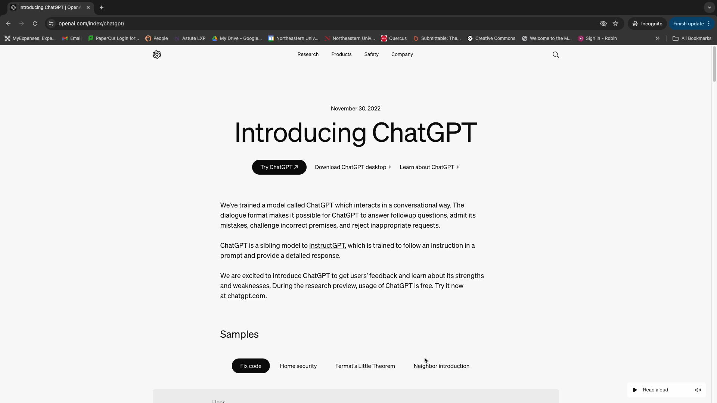
Chat GPT Bad Poetry Prompt
Sign up/in chatgpt.com
Create a 40 line poem
Experiment with prompts – ‘write a 40 line poem about dying printers’
Refine poem to make it as bad as possible… for example…
- Make it less snappy
- Include more cliches
- Make it less original
- Put more forced rhyme in there
- Just please, make it worse…

Slide 10


Break and Printing
Online group – begin break now
In Room Group – one more task…
Copy and Paste your poem in the document accessed via the email link
Paste under your name

Slide 11

Why Cut Up/Erasure?
‘Typography, layout, ink, material supports may be necessary for words to appear on a page, but they can also be deployed for other purposes, even at cross purposes, striking out at words, challenging their sense, altering or entirely subverting their meaning. By taking them up as compositional elements in their own right, experimental poets and artists of the avant-garde ask us to explore possibilities for creative expression in the purely visual, aural, tactile qualities of physical media. They ask us to look beyond words’ (Beyond Words, 2019).
= We use the machine against itself and highlight it’s a tool
= Avant-garde techniques pose questions of who is in control
This Photo by Unknown Author is licensed under CC BY

Slide 12



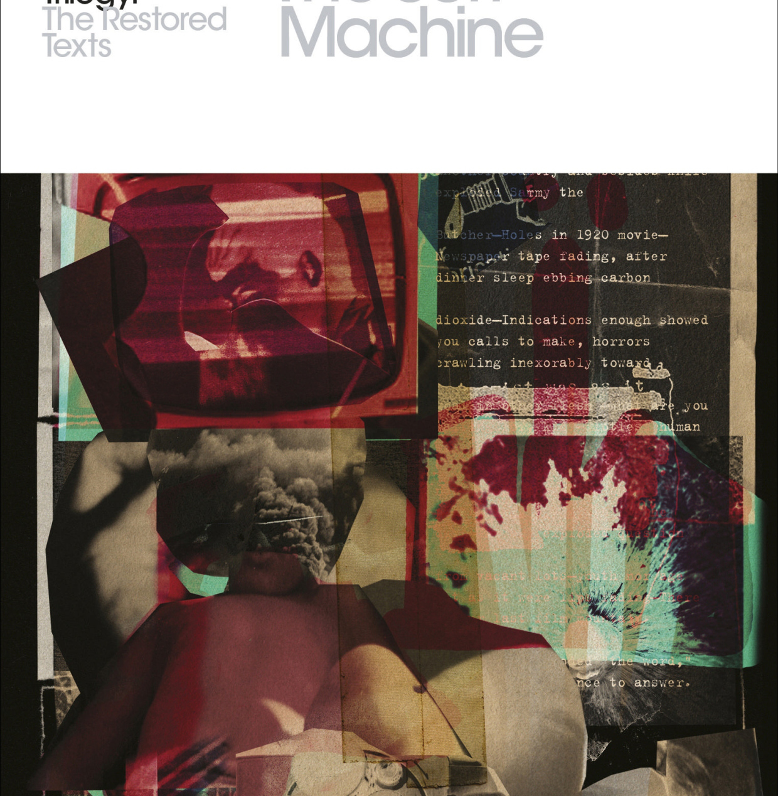
William Boroughs on Cut Up Poetry
In-Room Group
Watch: https://www.youtube.com/watch?v=Rc2yU7OUMcI
‘The cut up method brings to writers the collage which has been used by painters for fifty years. And used by the moving and still camera. In fact all street shots from movie or still cameras are by the unpredictable factors of passers by and juxtaposition cut ups. And photographers will tell you that often their best shots are accidents . . . writers will tell you the same. The best writing seems to be done almost by accident by writers until the cut up method was made explicit-- (all writing is in fact cut ups. I will return to this point)--had no way to produce the accident of spontaneity. You can not will spontaneity. But you can introduce the unpredictable spontaneous factor with a pair of scissors.’
from Leroi Jones, ed., The Moderns: An Anthology of New Writing in America (NY: Corinth Books, 1963).
This Photo by Unknown Author is licensed under CC BY-SA
This Photo by Unknown Author is licensed under CC BY-SA
This Photo by Unknown Author is licensed under CC BY-NC-ND
This Photo by Unknown Author is licensed under CC BY-NC-ND

Slide 13


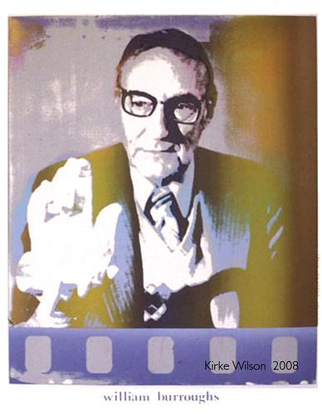

Cut Up Poem Workshop
In-Room Group
Use the scissors to cut out words and phrases from the poem. Glue these down in a new arrangement.
Experiment - seek out the unexpected connections (juxtapositions)
Find unintended rhymes/repeated sounds
Think about technology and the machine
Challenge yourself with a piece that pushes boundaries and your sense as to what poetry is
This Photo by Unknown Author is licensed under CC BY-NC
This Photo by Unknown Author is licensed under CC BY-SA-NC
This Photo by Unknown Author is licensed under CC BY-NC-ND

Slide 14
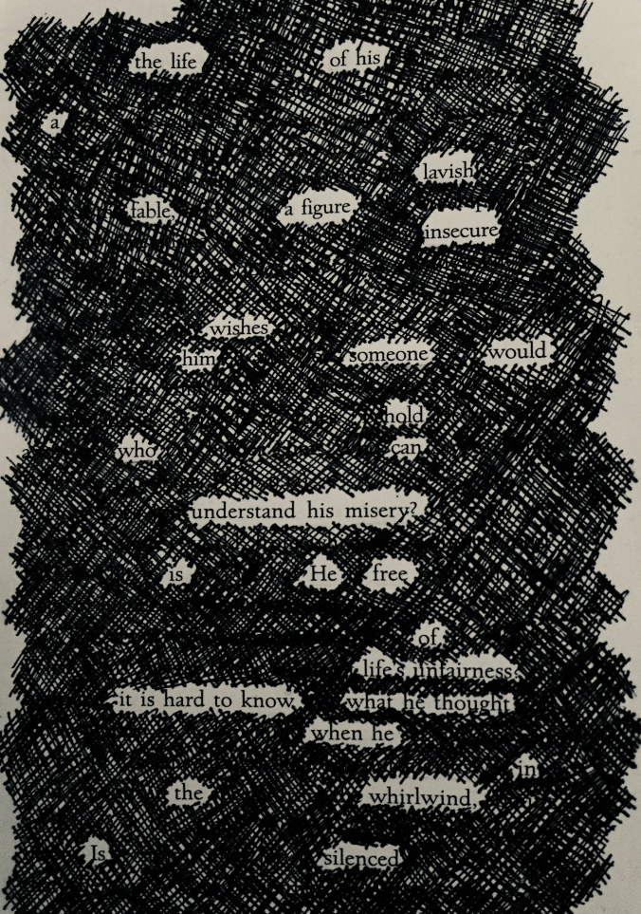
Erasure/Black Out Poetry
Online Group
‘Erasure poetry, also known as blackout poetry, is a form of found poetry wherein a poet takes an existing text and erases, blacks out, or otherwise obscures a large portion of the text, creating a wholly new work from what remains.
Erasure poetry may be used as a means of collaboration, creating a new text from an old one and thereby starting a dialogue between the two, or as a means of confrontation, a challenge to a pre-existing text.’
Academy of American Poets. 2019. “Erasure,” Poets.org (Poets.org - Academy of American Poets) <https://poets.org/glossary/erasure> [accessed 4 November 2024]
This Photo by Unknown Author is licensed under CC BY-SA
This Photo by Unknown Author is licensed under CC BY-NC-ND
This Photo by Unknown Author is licensed under CC BY-NC-ND
This Photo by Unknown Author is licensed under CC BY-NC-ND

Slide 15

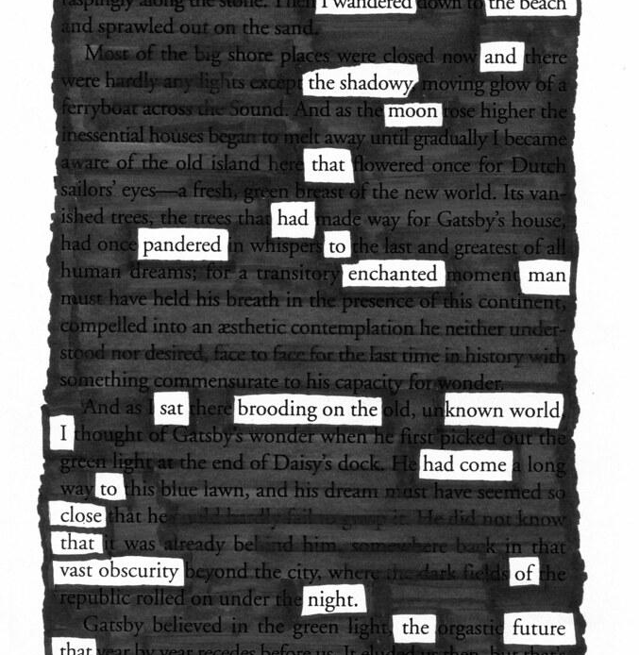

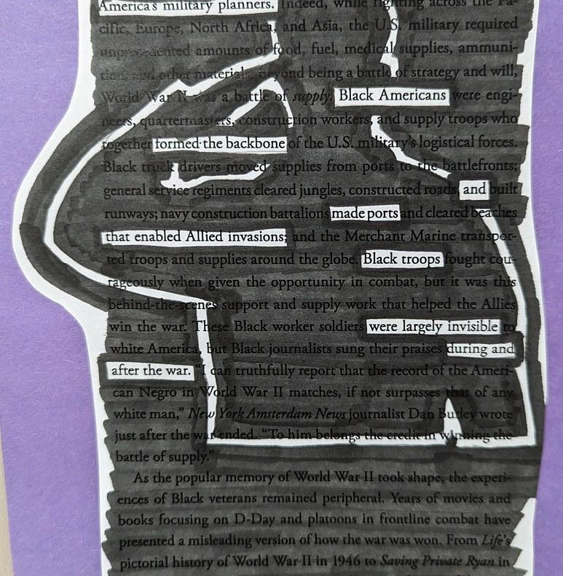
Erasure/Black Out Workshop
Online Group
Use the following site to create a blackout poem: https://www.classes.cs.uchicago.edu/archive/2022/summer/19911-1/blackout-poetry/starter/index.html
Practice on the starter/default page
Click on words to highlight them
When ready, click ‘Black Out’ to try it out
Copy and paste Chat GPT poem and try 5+ combinations to get a poem you’re happy with
Experiment - seek out the unexpected connections (juxtapositions)
Find unintended rhymes/repeated sounds
Think about technology and the machine
This Photo by Unknown Author is licensed under CC BY
This Photo by Unknown Author is licensed under CC BY-NC
This Photo by Unknown Author is licensed under CC BY-NC
This Photo by Unknown Author is licensed under CC BY-NC

Slide 16
References
Byron. 1812. “An Ode to the Framers of the Frame Bill,” Flashpointmag.com <https://www.flashpointmag.com/byframe.htm> [accessed 4 November 2024]
Byron. 1816. “Song for the Luddites,” Poetryverse.com <https://www.poetryverse.com/lord-byron-poems/song-for-the-luddites> [accessed 4 November 2024]
Brautigan, Richard. 1967. “All Watched Over By Machines Of Loving Grace,” Allpoetry.com <https://allpoetry.com/All-Watched-Over-By-Machines-Of-Loving-Grace> [accessed 4 November 2024]
Leroi Jones, ed., The Moderns: An Anthology of New Writing in America (NY: Corinth Books, 1963). [William Burroughs, "The Cut Up Method”]
QUEDEAR. [n.d.]. “Cut-Ups William S. Burroughs” (Youtube) <https://www.youtube.com/watch?v=Rc2yU7OUMcI> [accessed 4 November 2024]
Academy of American Poets. 2019. “Erasure,” Poets.org (Poets.org - Academy of American Poets) <https://poets.org/glossary/erasure> [accessed 4 November 2024]
Beinecke Rare Book & Manuscript Library Yale University. Beyond Words: Experimental Poetry and the Avant-Garde [2019 exhibition] <chrome-extension://efaidnbmnnnibpcajpcglclefindmkaj/https://beinecke.library.yale.edu/sites/default/files/files/BeyondWords_2019.pdf>

Slide 17

Q&A

Slide 18






NortheasternLDN
THANK YOU
Devon House
58 St Katharine’s Way
London
E1W 1LP
United Kingdom
Tel: +44 (0)20 76374550
info@nulondon.ac.uk
www.nulondon.ac.uk

Slide 19
