Slide 1
Maps to Arkham
Lovecraft, Landscape and Visual Poetry
Dr Sam Kemp

Slide 2
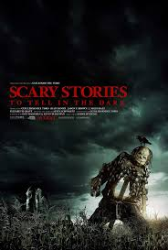
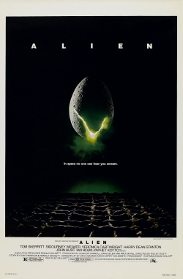
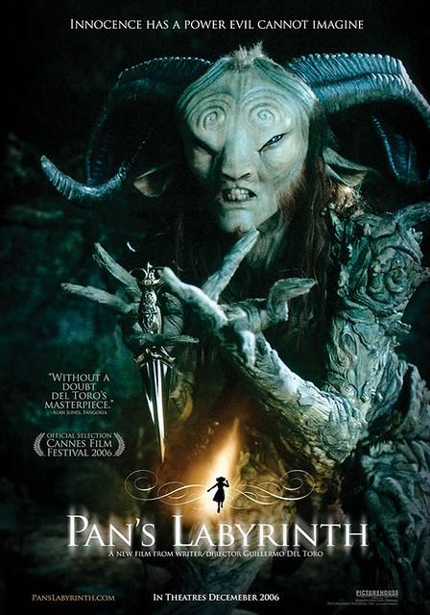
H.P Lovecraft and Creative Writing
The Nameless City (1921):
‘When I drew nigh the nameless city I knew it was accursed. I was traveling in a parched and terrible valley under the moon, and afar I saw it protruding uncannily above the sands as parts of a corpse may protrude from an ill-made grave’ (2017: 5).
China Miéville: There’s something about that kind of hallucinatory intense purple prose which completely breaches all rules of “good writing”, but is somehow utterly compulsive and affecting’ (Loc. 2847, quoted in Roland) [emphasis my own].
Notes:
The first time I read Lovecraft I was disappointed. It was The Nameless City (1921), admittedly one of his earlier works. It begins…
When I drew nigh the nameless city I knew it was accursed. I was traveling in a parched and terrible valley under the moon, and afar I saw it protruding uncannily above the sands as parts of a corpse may protrude from an ill-made grave (2017: 5).
It’s not terrible, but I was expecting more. He is an enduring influence on some of contemporary writing’s greatest genre writers, musicians and filmmakers. Some of the most popular genre writers today are devoted fans. Stephen King, Neil Gaimen, and China Mieville have all cited him as an influence. Guillermo Del Toro and John Carpenter owe part of their cinematic style to him, writing and directing some of today’s most well-known horror films: Pans Labyrinth, Scary Stories to Tell in the Dark, the Hellboy trilogy, and The Fog, At the Mouth of Madness and the Halloween franchise, respectively. His influence on modern sci-fi is enormous. Del Toro highlights that one of the biggest sci-fi franchises, Ridley Scott’s Alien, encompasses a typically Lovecraftian premise - that of the unwitting expedition stumbling on a long-slumbering extra-terrestrial object (in Roland 2014: Kindle Loc. 2358). On a more literary scale, Joyce Carol Oates has spoken about him with reverence and responses to his work can be found in the feminist fiction of Angela Carter (Wisker 2019). His genre-defining stories have been reprinted next to some of sci-fi’s most respected contemporary voices: J. G. Ballard, Philip K. Dick and Ray Bradbury, for example (Roland 2014: loc. 3325). He’s spawned a colossal seemingly-free-for-all fictional “Mythos” which writers today still respond to, most recently Lovecraft’s Monsters (Ellen Datlow: 2014). There’s Lovecraft board games, cuddly toys and enamel pin badges, as well as countless tattoos. There’s even a Lovecraft-inspired cookbook - The Necronomnomnom (Mike Slater, 2019). Lovecraft loomed, and still looms, large over the genre of Weird fiction and beyond. In fact. For any fan of horror, sci-fi or the Weird, the name Lovecraft is inescapable. He’s essential reading, as Neil Gaiman has said ‘‘You need to read him – he’s where the darkness starts” (Roland, Loc. 52). This is why, like me, you may be surprised when you start reading him.
And yet, despite the absence of craft, there is something which keeps you reading. Award winning writer China Miéville (2014) describes the challenge this presents to writers: There’s something about that kind of hallucinatory intense purple prose which completely breaches all rules of “good writing”, but is somehow utterly compulsive and affecting’ (Loc. 2847, quoted by Roland) [emphasis my own].
Verbose. Melodramatic. A technical failure. He’s everything the creative writing teacher swears against. And yet, a year on from reading The Nameless City, I went on to dedicate a 70-page poetic sequence to his landscapes and spent every spare moment I had consuming his fiction, criticism, correspondence and biographies, as well as those of his contemporary influences. I was, and still am, obsessed. Lovecraft has this effect. Something keeps you reading, an impulse which actually relies on the fact he’s not a traditionally “good” writer.
It was Lovecraft’s inefficient prose and reverence for archaic and flowery language, the constant repetition of horror-filled adjectives; essentially everything “good writing” steers against, which inspired my own equally suffocating poetic response. The response was only partly prompted by his language, but also the vital role his landscapes play in grounding the ‘Weird’ firmly in our world.

Slide 3
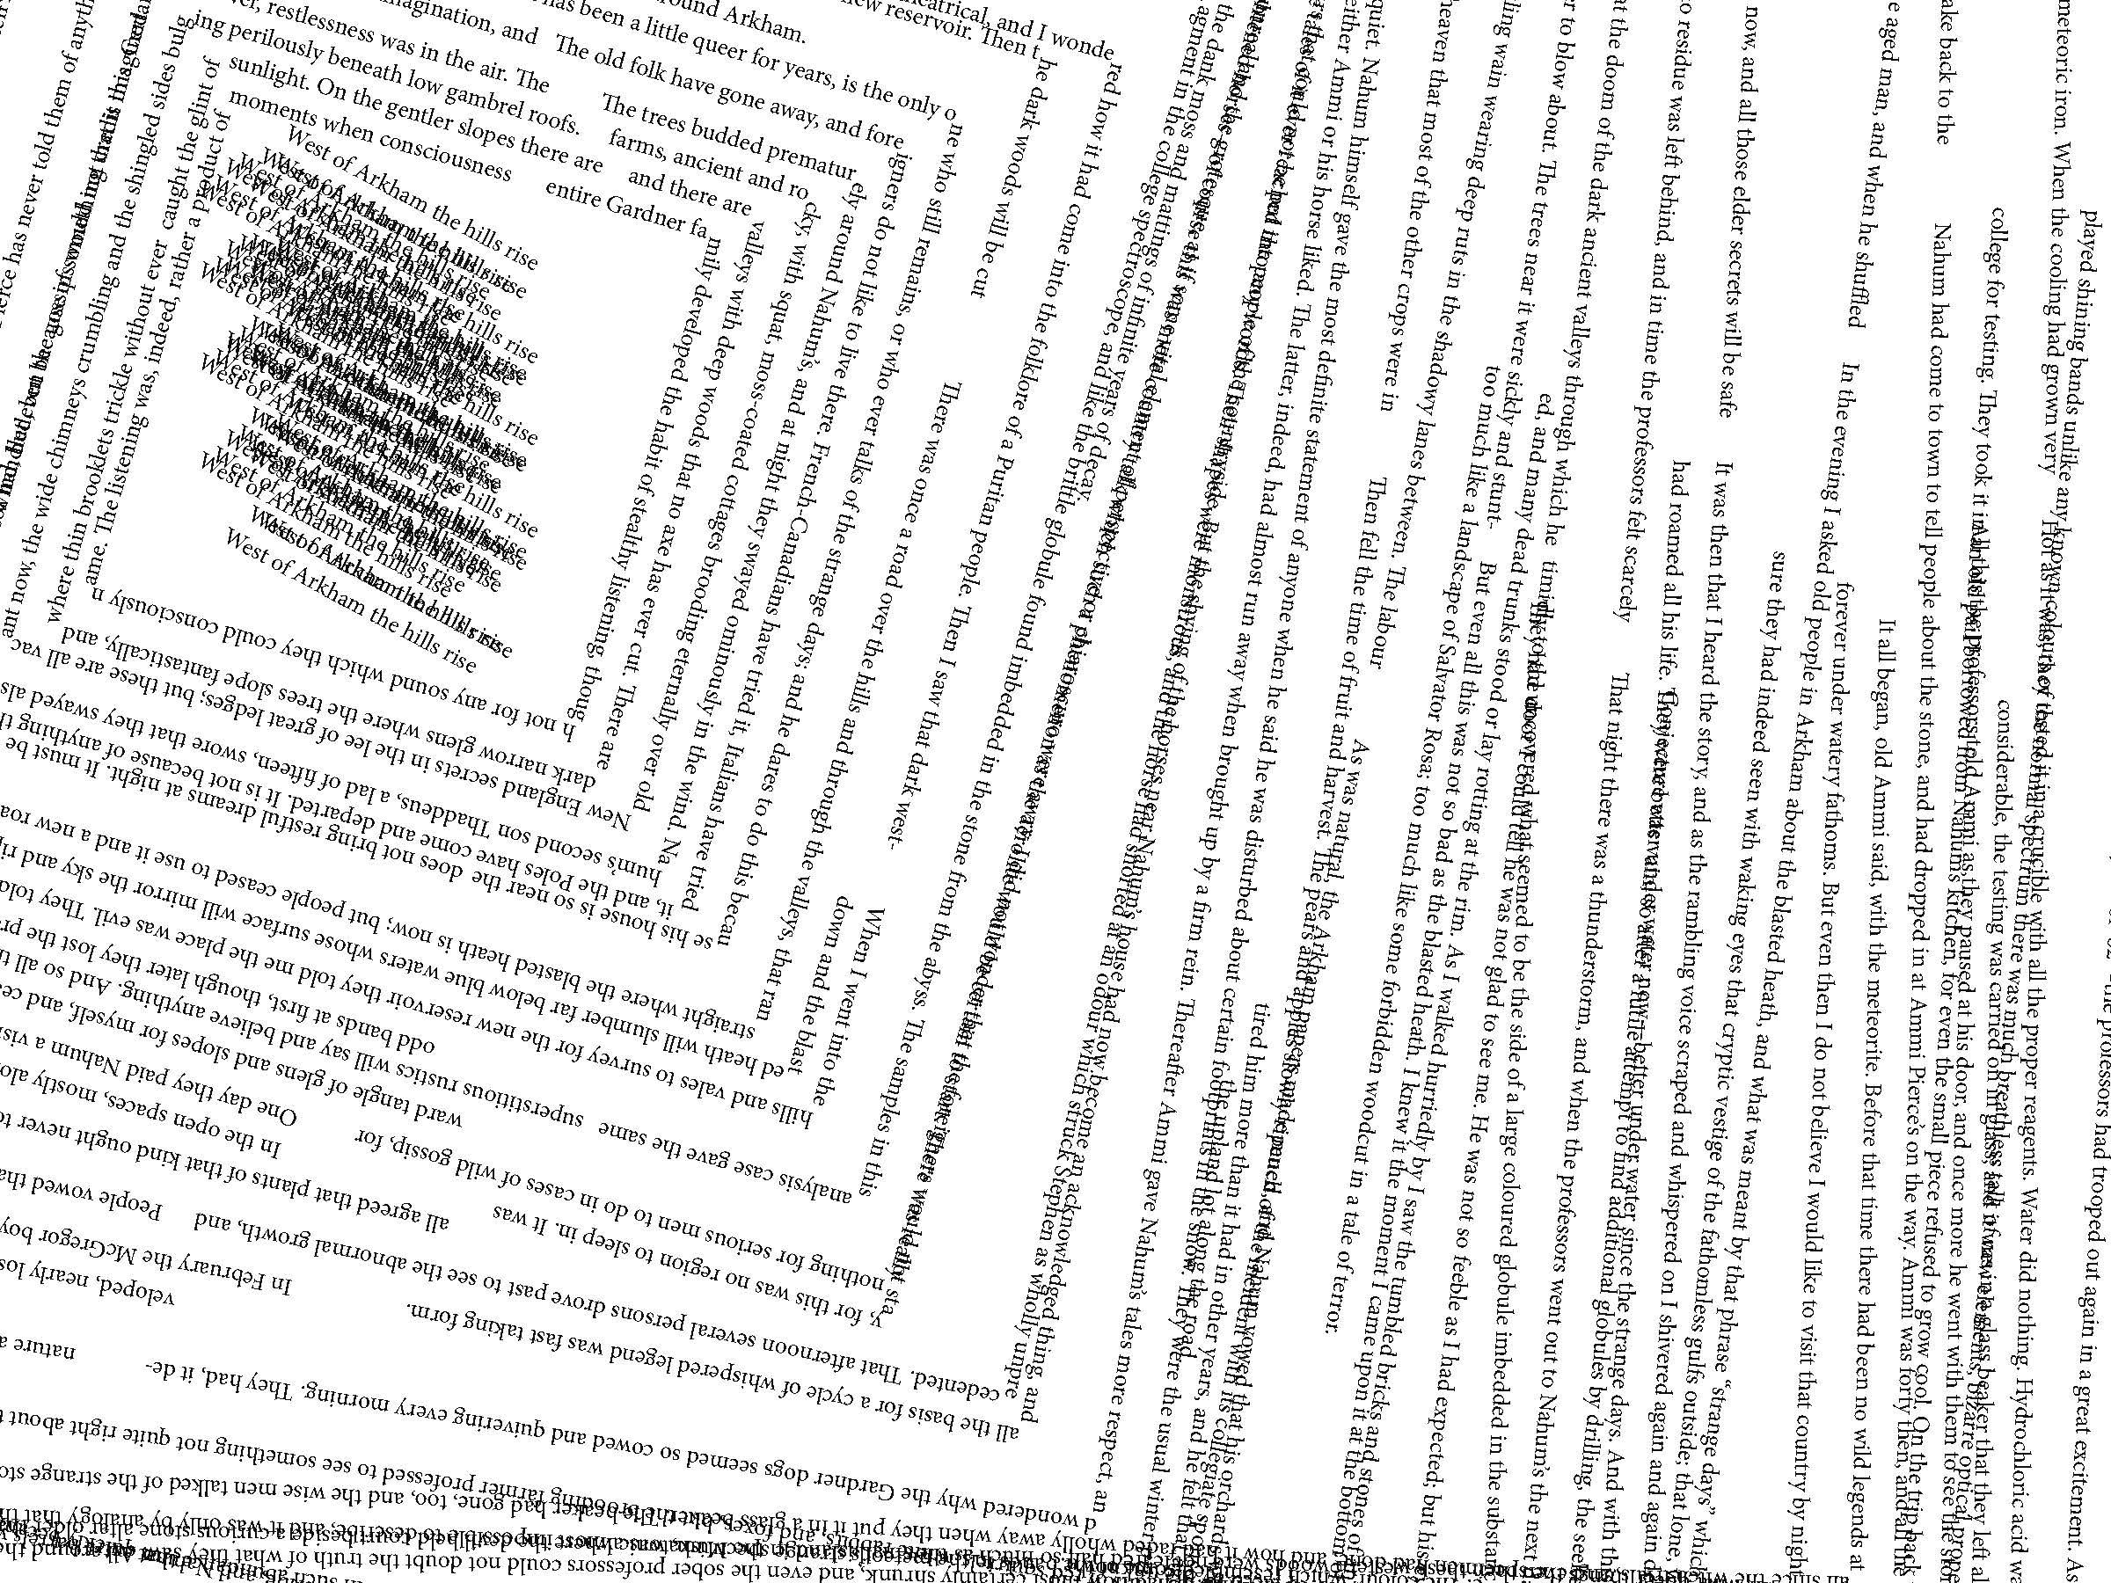
Map 3
(The Nahum Gardner Farmhouse,
The Blasted Heath, West of Arkham)
On the gentler slopes there are farms, ancient and rocky,
with squat, moss-coated cottages brooding eternally over old
New England secrets in the lee of great ledges; but these are all vacant now, the wide chimneys crumbling and the shingled sides bulging perilously beneath low gambrel roofs.

Slide 4
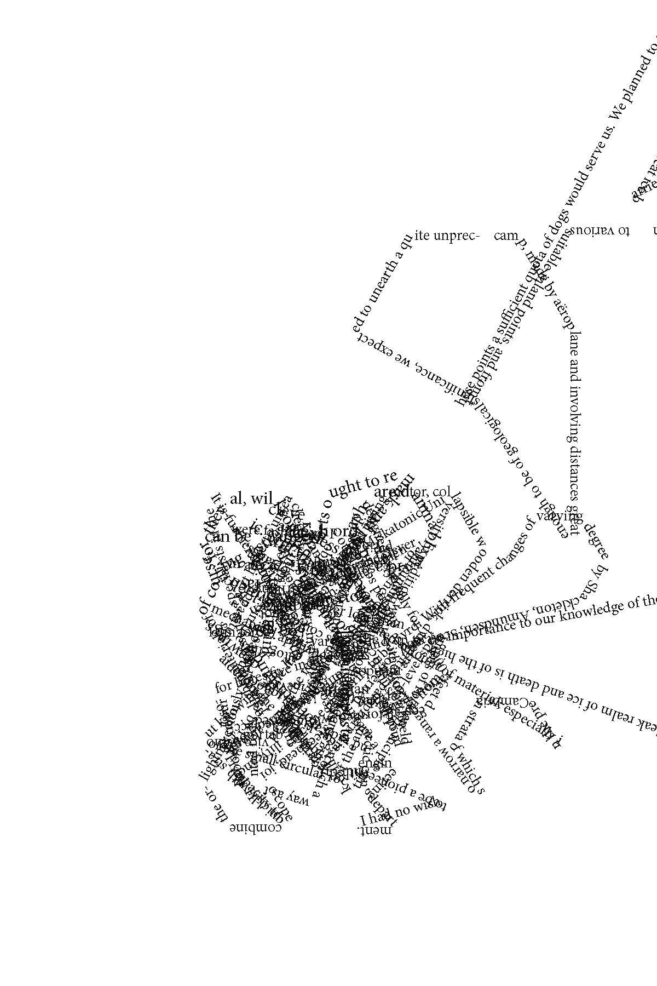
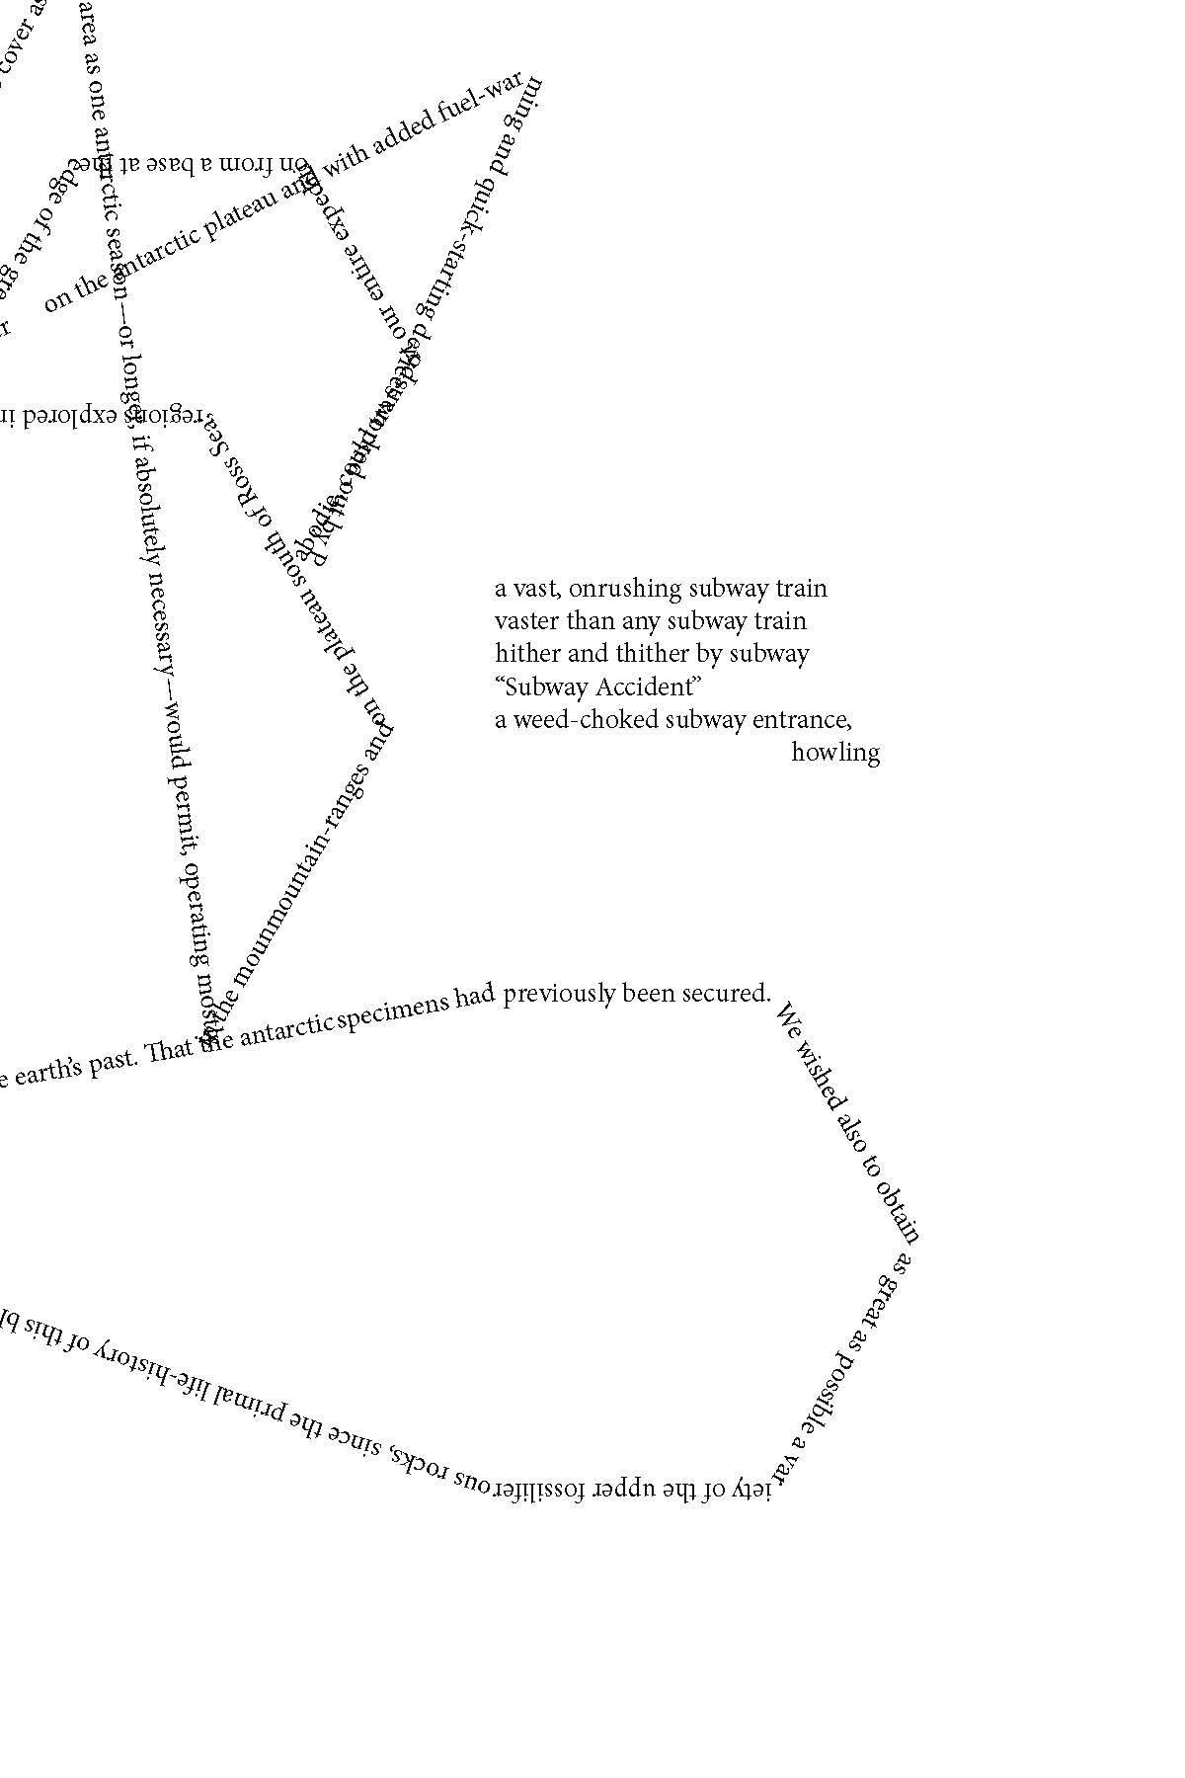
Psychogeography and Cyclopean Architecture
At the Mountains of Madness
‘…no architecture known to man or to human imagination, with vast aggregations of night-black masonry embodying monstrous perversions of geometrical laws and attaining the most grotesque extremes of sinister bizarrerie’ (Lovecraft, 2017 [1931], 166).
‘...from a dérive point of view cities have psychogeographical contours, with constant currents, fixed points and vortexes that strongly discourage entry into or exit from certain zones’ (62).
Notes:
In At the Mountains of Madness, one of Lovecraft's most influential stories, a group of Arctic drilling explorers uncover a 50 million year old alien city which is made up of…
‘no architecture known to man or to human imagination, with vast aggregations of night-black masonry embodying monstrous perversions of geometrical laws and attaining the most grotesque extremes of sinister bizarrerie’ (Lovecraft, 2017 [1931], 166).
The city is, like so many of Lovecraftian inventions, indescribable. It wriggles free of articulation because the human language lacks the words to describe it. Its perverted ‘geometrical laws’ make it an impossibility, meaning its existence is both beyond reason and yet, for the survivors of the expedition, horrifyingly real. As mentioned earlier, this cognitive dissonance is the real danger, provoking madness and panic which could consume society. But Lovecraft’s interest in alien architecture stems from a more grounded origin, and is linked with his love of walking.
He took friends and colleagues on all-night epic journeys across more typically undeserving terrain: graveyards, alleyways, wharves, backstreets; anywhere holding some energy from the past. These walks were a big part of these New York years. David Haden (2011) explains how Lovecraft, in his walking habits, was something of a radical in 1920s America:
‘In a city just a few years away from the brink of a new car-borne hostility to the pedestrian, his walking, Lovecraft’s cross-cutting of histories, his seeking out of little known routes, his stopping to look up at the buildings instead of into shop windows, his stepping back into the street for a better view — all these acts can be seen as implicit varieties of subversion of the ‘normal’ commercial experience of the modern city’ (Loc. 78).
As Haden’s Book, Walking with Cthulhu, investigates, the puritanical Lovecraft actually formed a practice that foreshadowed the radical walking theorizing of the mid-twentieth century Situationists, a group of artists and political activists who played a part in the Paris Student Riots of May 1968. The Situationists were an anti-capitalist revolutionary group who theorized a world in which, according to Alastair Hemmens and Gabriel Zacarias (2020), “art” needed to be “abolished as a separate activity and integrated into the totality of everyday life” (3).
Stemming from Dada, Surrealism and, more directly, Lettritism, The Situationists developed artistic practices in order to undermine a capitalist agenda (The Spectacle), particularly that which is present in the urban environment. One technique was the dérive, or drift, an aimless wander which paid special attention to, and moving, in whatever way, with, the emotional and atmospheric effects of the environment. As Guy Debord, the leading voice of the movement, explains in Theory of the dérive (2006 [1958]), the dérive is not just about chance encounters with surprising elements of place, but about recognizing and counteracting the flows of direction which the urban environment facilitates.
‘...from a dérive point of view cities have psychogeographical contours, with constant currents, fixed points and vortexes that strongly discourage entry into or exit from certain zones’ (62).

Slide 5
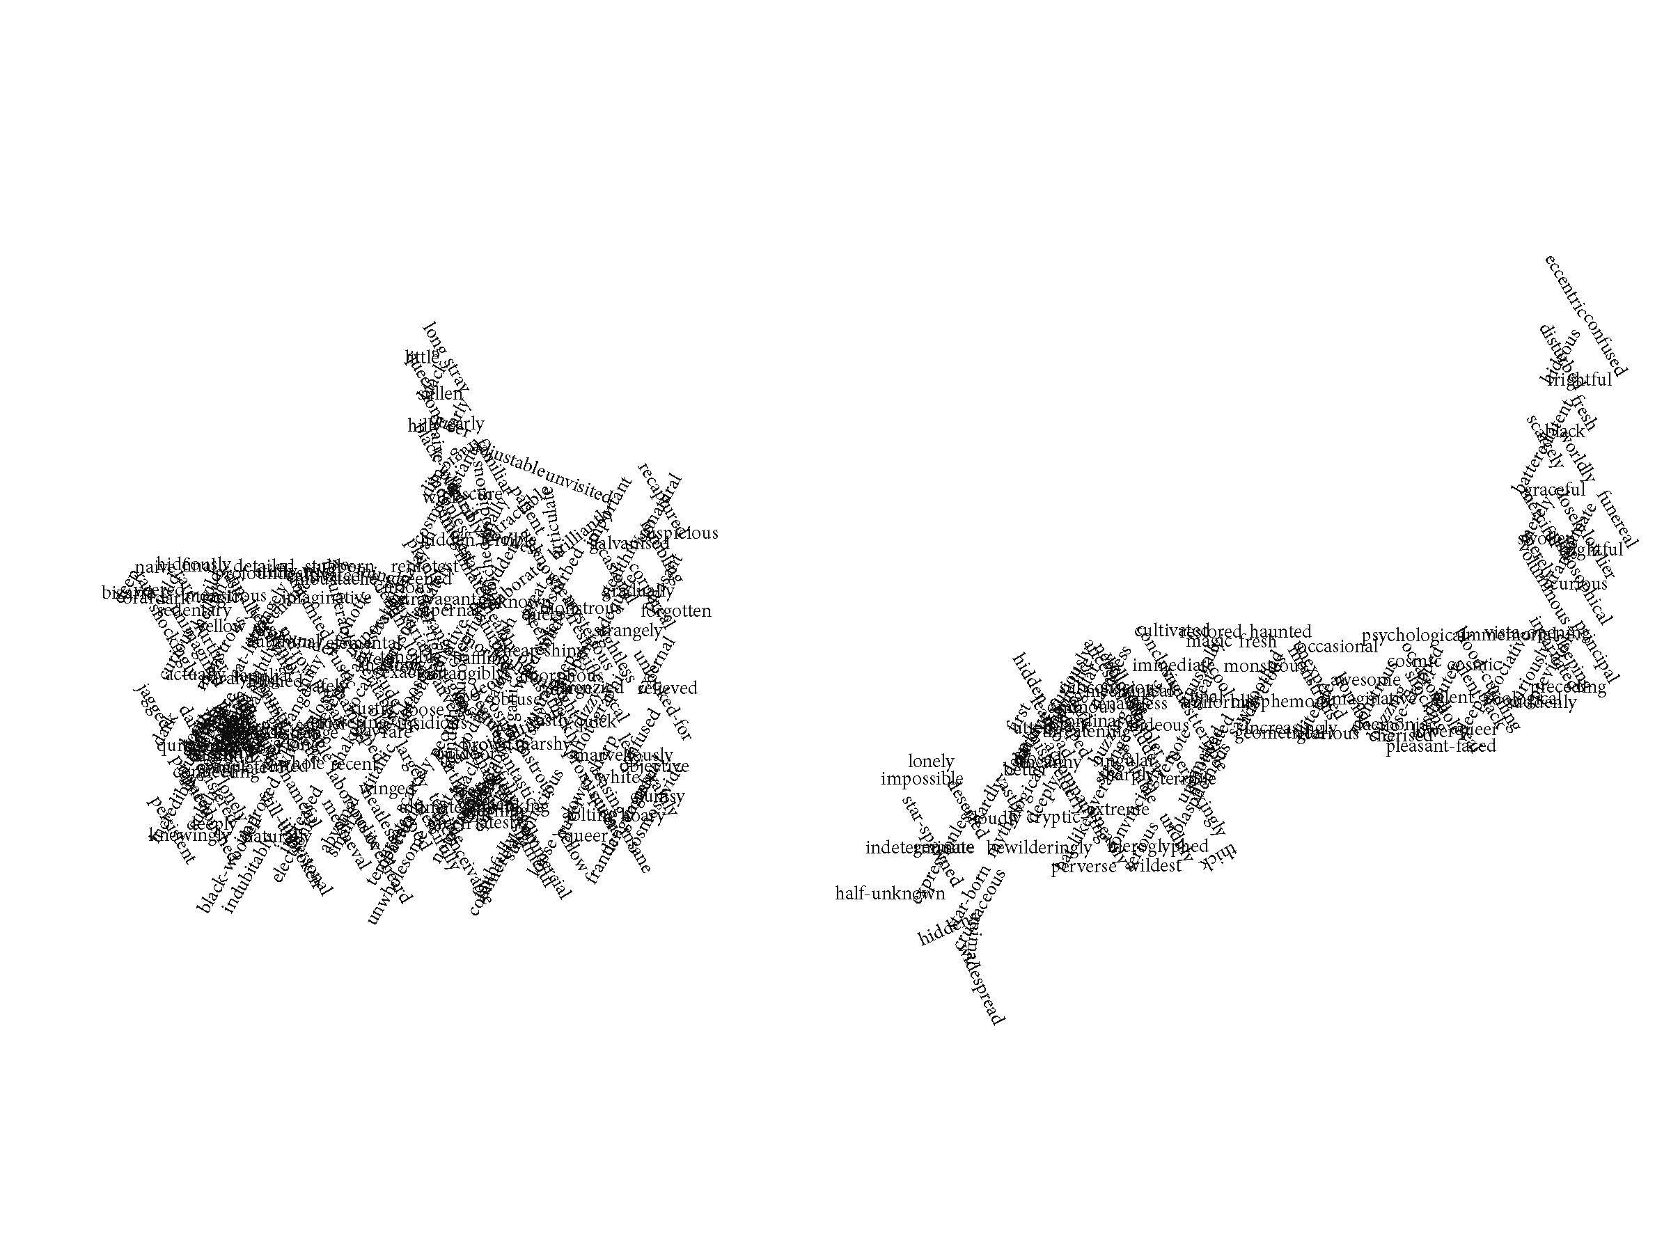
Map 4
(The Akeley Farmhouse, Vermont)
There were gorges where untamed streams leaped,
bearing down toward the river the unimagined secrets
of a thousand pathless peaks.

Slide 6
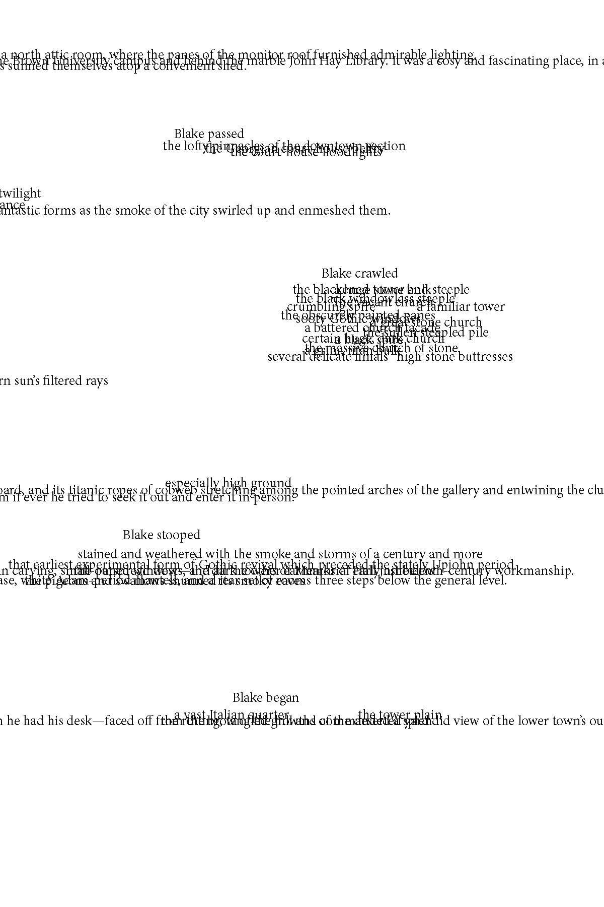
Détournement and the Indescribable
’...’also’ is the hallmark of the treated text’s appropriation. Keeping both source and derivative simultaneously in view, and making visible the traces of that double presence, the treated text is less a parasite on its source than a pair of sights’ (Dworkin: 136).
Notes:
The Lovecraftian and Situationist senses of architecture and walking have fed into the visual arrangements of Maps to Arkham. But there is one other Situationist theory which is central to the work, although it has little to do with Lovecraft’s life or writings. Détournement is the act of misappropriating a textual or visual source and creating a new arrangement of a source material. In French, detourner means to hijack, and the verb, as Craig Dworkin (2003) explains, signals some kind of “illicit diversions: embezzlement, misappropriation, hijack…” (13). This hijack of an original source, a painting or book, for example, relies on the new relations created between the source and its new arrangement. It celebrates a layering which is free to achieve excess:
...’also’ is the hallmark of the treated text’s appropriation. Keeping both source and derivative simultaneously in view, and making visible the traces of that double presence, the treated text is less a parasite on its source than a pair of sights (Dworkin: 136).
This means that, although plagiarism is a fundamental part of the practice, an act of détournement does not simply borrow words or images from another source, but re-arranges them in such a way that creates tension between the original and its rearrangement. The original’s presence is key to this depth of investigation in the artwork.

Slide 7
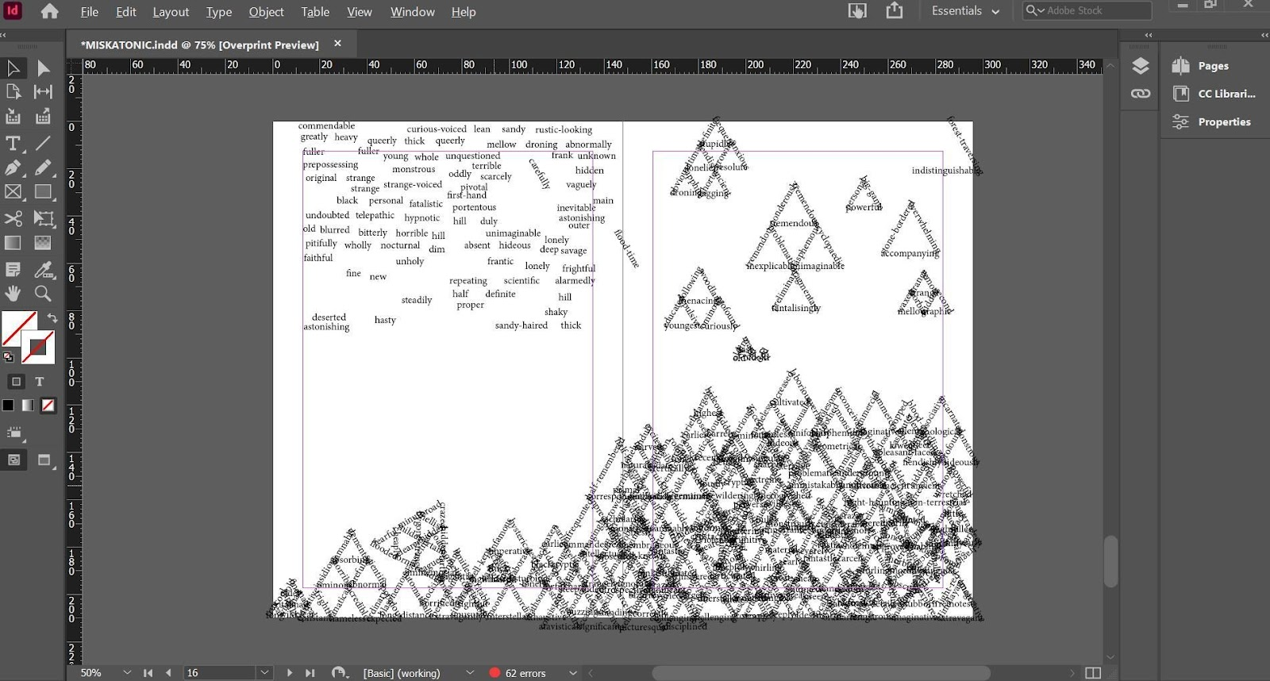
Notes:
Maps to Arkham is a roadmap to some of the most infamous locations in Lovecraft country. It forms a kind of anti-guide to the concretism of place, a mapping of the weird which disorientates as much as reveals.
…each visual rendering of a landscape is built from Lovecraft’s texts. The visual poem is then accompanied by a more typical poetic response. Both sides, the visual map and the line by line response, form a singular “map” enacting the Lovecraft mythos and its enduring influence.
The sequence started as a parody of Lovecraft’s adjectivitis; his obsession with architecture, walking, and landscape, but most of all, his repetitive, overwhelming prose style. The first few poems work through Lovecraft’s verbose prose. I took every adjective and adverb from The Nameless City and copied and pasted them into an A5 InDesign document. It formed a dense and threatening shape shifting in and out of legibility. The Gilman House, in which a band of degenerate Innsmouth amphibians raid the narrator’s room, was the second poem. The result was an even bigger and darker object, a force as large and complex as that at the door.
The process of creating these first two visual poems was tediously long. I trawled through the text, identified what I needed then arranged them on the page. It took countless hours of laborious repetition just to gather the building blocks, and even then, there was no definite aim. I didn’t want to begin with a prescribed notion of what each map would look like, but rather let each one emerge as a product of the circumstances of the individual landscape it responded to. There were three actors involved: myself, Lovecraft’s fiction, and the Adobe InDesign software. The process of collage occurred between us. This type of visual poetry is nothing new, although the use of InDesign does open up new possibilities for the use of the page. A closer look at another project which appropriates out-of-copyright found text will contextualize the détournement process.

Slide 8
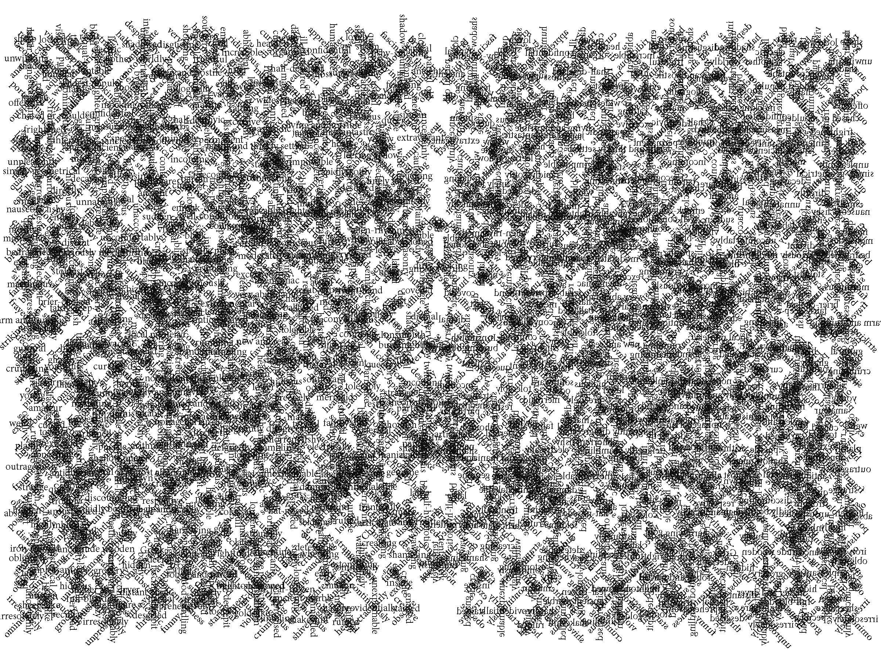
Map 2
(Room 428, The Gilman House, Innsmouth)
Without the least shadow of a doubt, the lock on my hall door
was being tried—cautiously, furtively, tentatively—with a key.

Slide 9
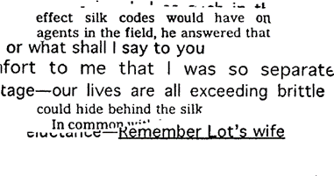
Susan Howe’s Frolic Architecture
Restricting oneself to a personal arrangement of words is mere convention. The mutual interference of two worlds of feeling, or the juxtaposition of two independent expressions, supersedes the original elements and produces a synthetic organisation of greater efficacy (Debord and Wolman 2006 [1956]: 15).
I cut into passages from my transcriptions with scissors, turned and adjusted them, taped sections onto sections, ran them through the copier, then reworked and folded over the results. The mirroring effects leads me on (218).
Right: Poem from Frolic Architecture, an unpaginated sequence contained in Susan Howe’s 2010 collection That This
Notes:
Poet Susan Howe’s sequence Frolic Architecture (2010) appropriates text from the archives of eighteenth-century theologian Jonathan Edwards and his family. As she recounts in Spontaneous Particulars: The Telepathy of Archives (2014) the sequence is a collection of “letters, diaries, notebooks, essays, and more than twelve hundred sermons” (45). Howe’s “frolic” sense of space is packed with visual movements, sparks of half-legible texts acting against another in an unstable sense of time and place. Howe’s process relies on “intuition”, a “factual telepathy”, that allows her to feel the “enduring relations and connections between what was and what is” (43). The poems in Frolic Architecture perform a Situationist détournement; a creation, or rather, curation, resulting in a new organization of meaning, as Debord champions.
Restricting oneself to a personal arrangement of words is mere convention. The mutual interference of two worlds of feeling, or the juxtaposition of two independent expressions, supersedes the original elements and produces a synthetic organisation of greater efficacy (Debord and Wolman 2006 [1956]: 15).
This “greater efficacy” is similar to what Howe describes as the “felt fact” (2012: 47) of ideas. Although seemingly contradictory, it’s Howe’s intuitive re-positioning of material that leads to a greater efficacy of Edwards’ communication, or rather, the “felt fact” of those ideas rather than their direct articulation. In other words, it’s only by not saying something directly that we can more effectively communicate it. In distorting his sermons on faith, Frolic Architecture conveys Edwards’ themes of belief and morality in a surprising and engaging way. At a basic level, this type of response is more immediately innovative than an ekphrastic response. Instead of paraphrasing or reflecting his work, Howe distorts it, creating visual shards of individual meaning that create a web of the “felt fact’ of the Edwards materials, all relying on the actual text used. For Howe, this act of détournement, an embracing of mis-communication, is actually the heart of poetry’s communicative abilities. Howe describes poetry as the love of this fact, a visual and textual distillation of communication.
Howe expands on her process of writing the sequence in an interview with W. Scott Howard (2019), suggesting how it was the process itself that took precedence over any prescriptive aims:
I cut into passages from my transcriptions with scissors, turned and adjusted them, taped sections onto sections, ran them through the copier, then reworked and folded over the results. The mirroring effects leads me on (218).
This “mirroring” is key to approaching her détournement of the text. The poem looks inward but only in order to splinter new meanings from its own disparate shards. It’s clear that Howe’s process was open enough to allow a more instinctual curation to happen, each step of the process leading to the next one, and an overall picture forming only at the very end.

Slide 10
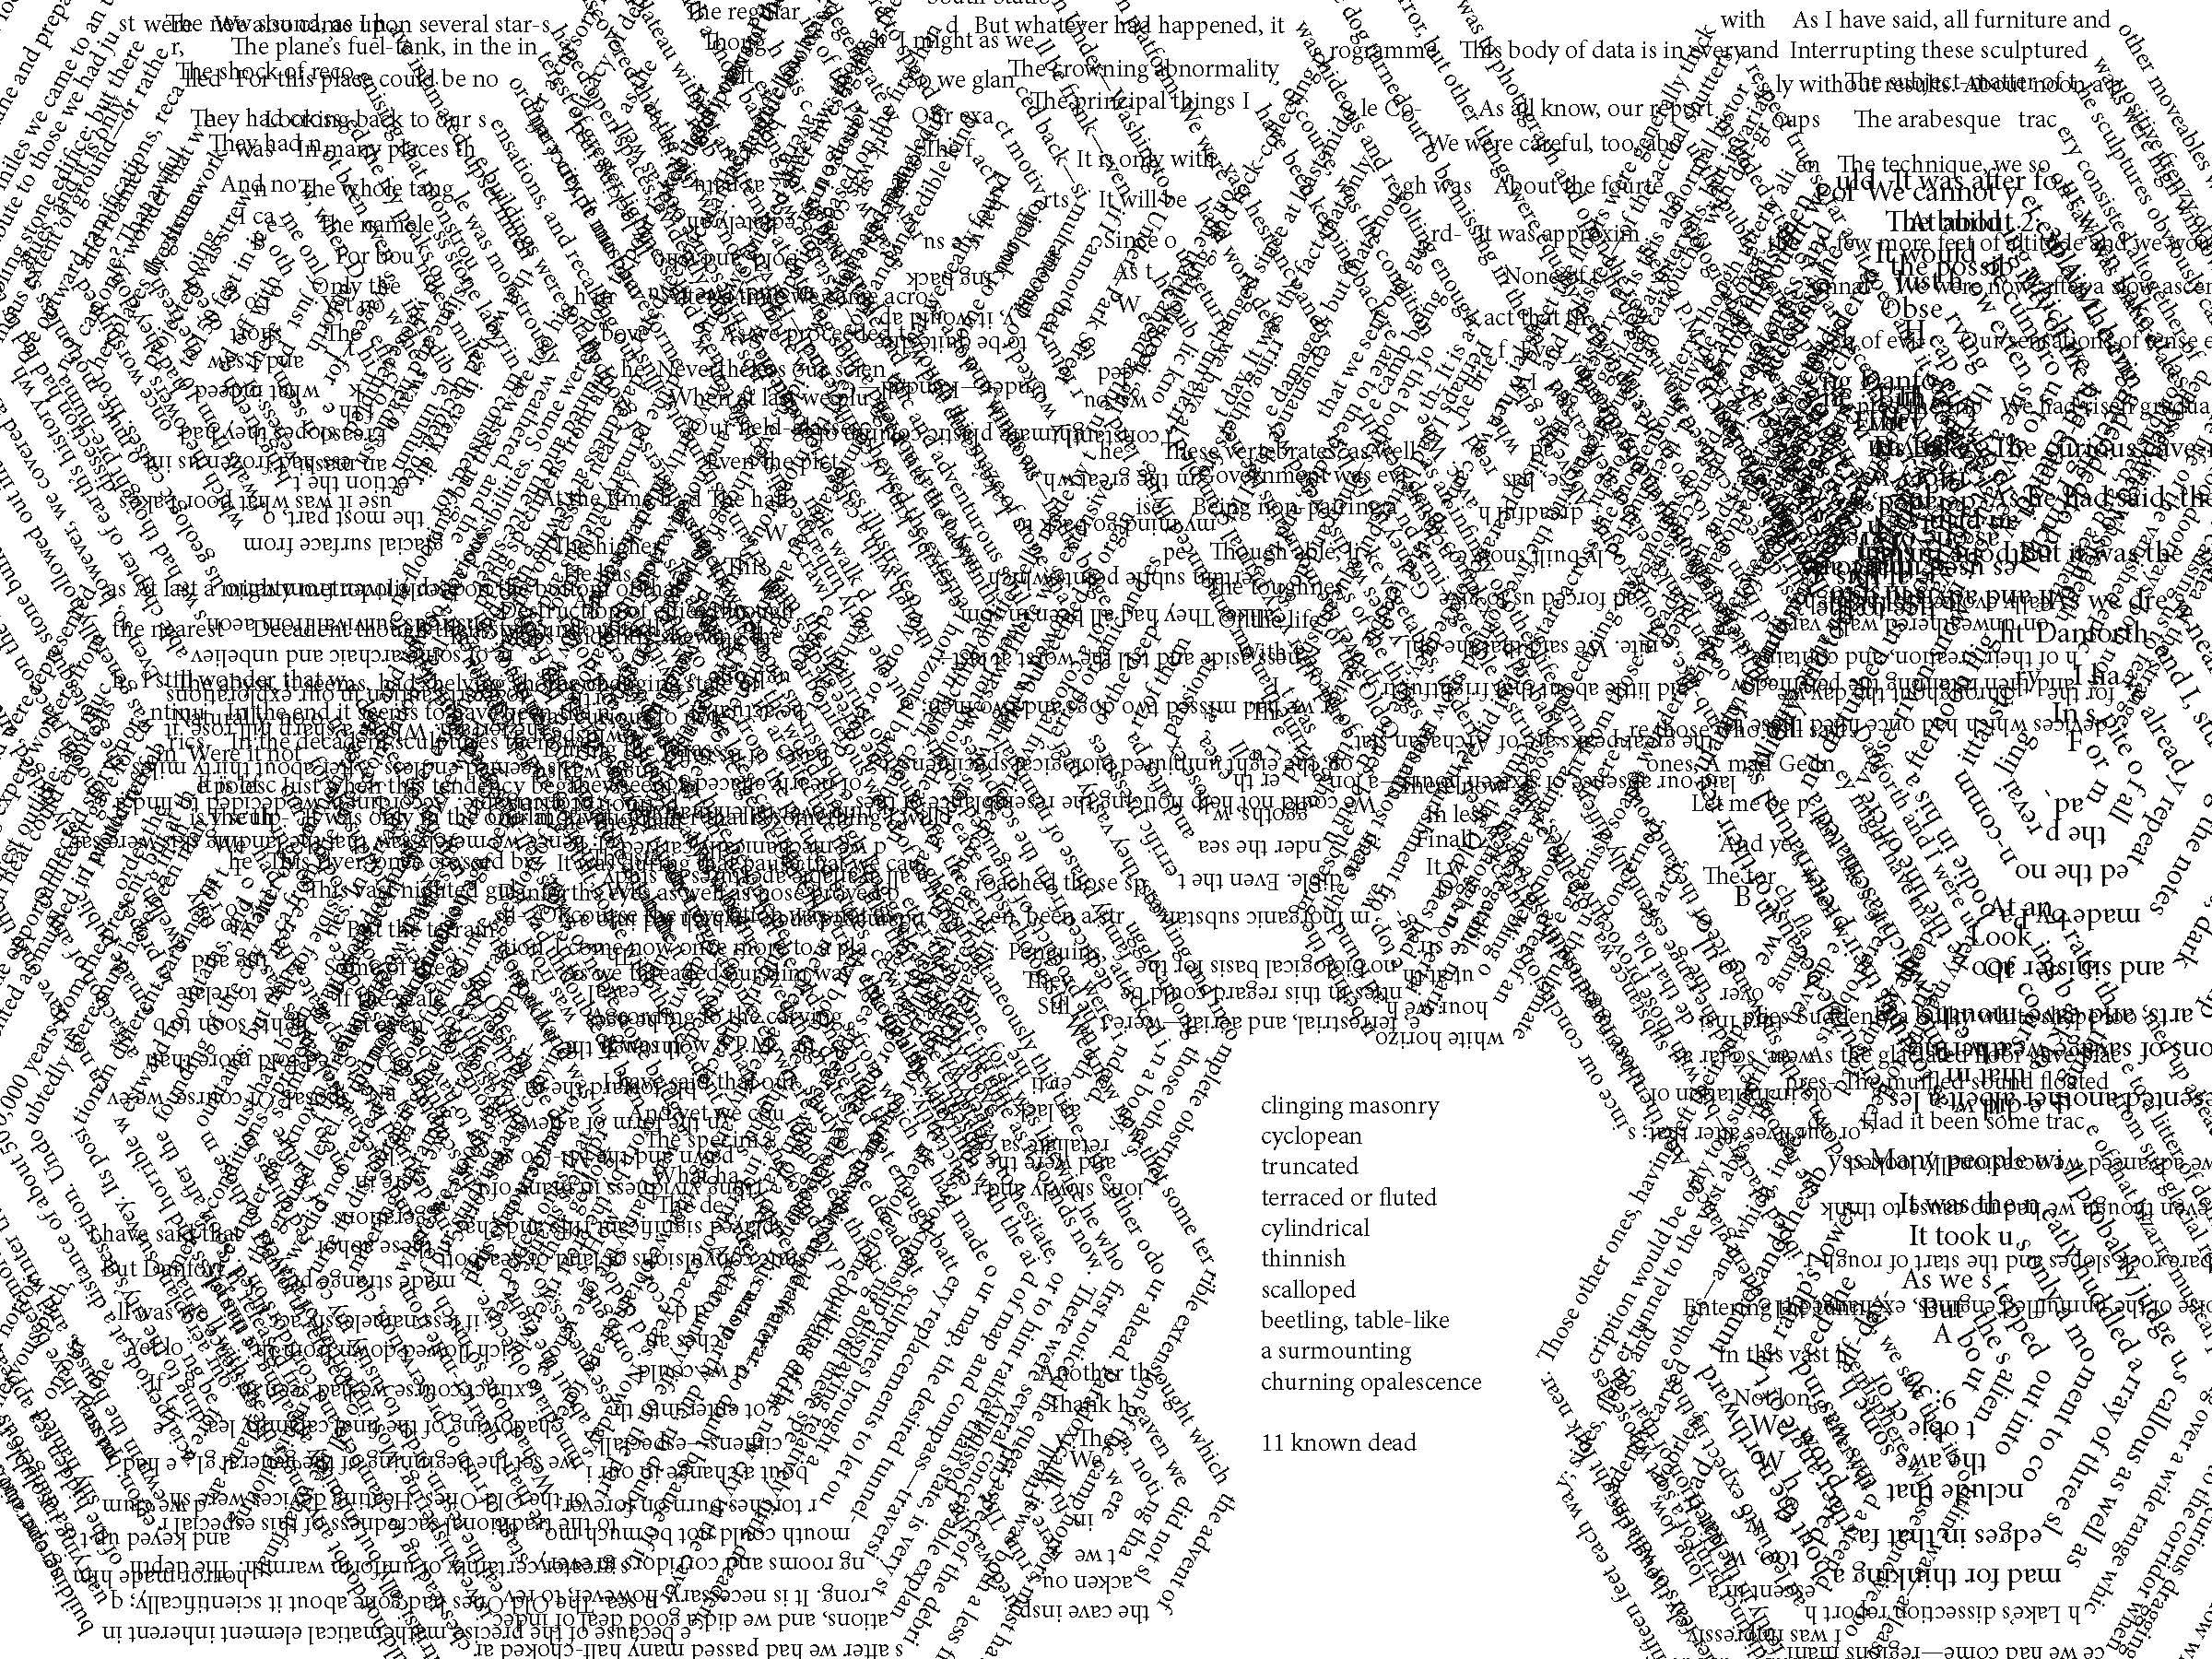
Map 5
(The Arkham, anchored in McMurdo Sound, Antartica)
There were truncated cones, sometimes terraced or fluted, surmounted by tall cylindrical shafts here and there bulbously enlarged and often capped with tiers of thinnish scalloped discs; and strange, beetling, table-like constructions suggesting piles of multitudinous rectangular slabs or circular plates or five-pointed stars with each one overlapping the one beneath.

Slide 11
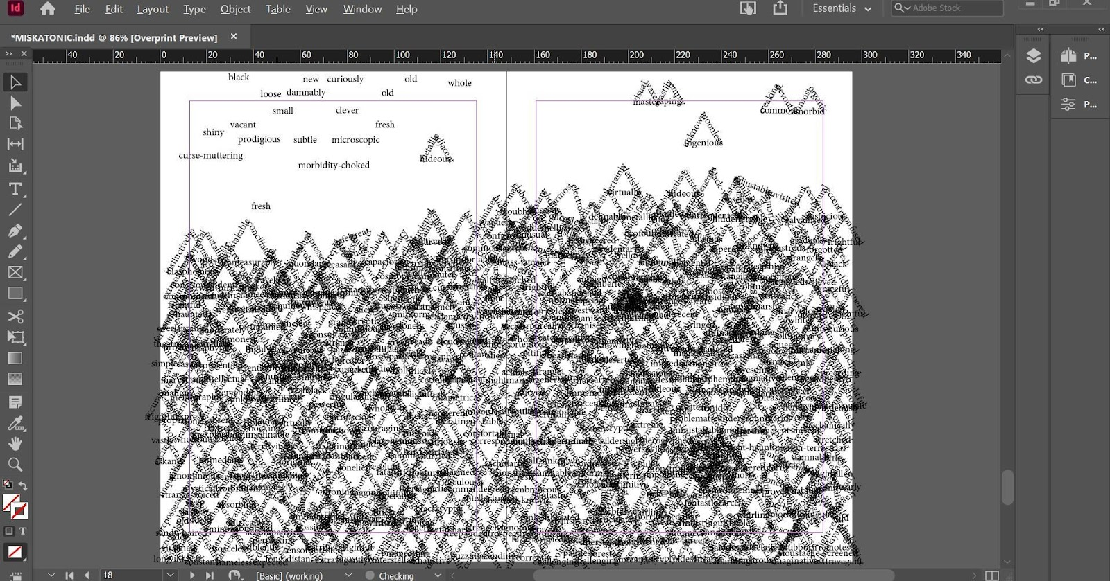
Notes:
Just as Howe had the Edwards text, her own poetic and visual instincts, and scissors, glue and a photocopier all weighing in on the sequence, Lovecraft’s voice and the design software was suitably close as I digitally cut into the material. The third agent here, Adobe InDesign, formed a much bigger role than I had initially imagined, often guiding the build of each poem with the possibilities, limits and specific features of the software.
In The Akeley Farmhouse, Vermont, the “map” appropriates all the verbs and adverbs from Lovecraft’s The Whisperer in Darkness. To begin with, I built triangles from similar sized words, combining them into larger pyramids where possible. It’s a simple process which cuts through the heavy Lovecraftian fiction and exposes the weight his adjectives form.
With each slow architectural build, a map started to emerge. The text on the left is in a kind of holding zone, awaiting shaping, while ladders of shaped text accumulated on the other side of the page. I layered and layered more pyramids on top until the text became dense, barely legible. Poet Joanna Drucker (1998) speaks about the “visual logic” of language on the page and I attempted to embody a Lovecraftian logic in the form of each map, as befitting to the individual story. As mentioned, the Vermont landscape of The Whisperer in Darkness is one heavy with a threatening pastoral and untainted wilderness: “…something in the collocation of roofs and steeples and chimneys and brick walls formed contours touching deep viol-strings of ancestral emotion” (69). At first, I struggled to find this threat on the page. But as the layering continued, more contour lines started to form.
I followed these contours of text up the page, positioning pyramids into a heavy arrangement. The growing “map” felt like a kind of manufactured soil, black and sticky but struck through with steel-like lines which cemented the text in place. I wanted dense and overwhelming, and the text delivered. As the image built, focal points began to develop. Darker corners of text provided solid structures by which to navigate the emerging contours.
The InDesign rotate tool and general ease of positioning text had enabled me to build the image, but these are just the basics of the programme. The “Direction Selection Tool” has more promising potential. As I reached the end of the text, the page was nearly full. Big triangles popped out in the general scrum and a series of disjointed horizontal lines shifted the eye up and down. However, as a “map”, it didn’t embody Lovecraft’s Vermont. In The Whisperer in Darkness, the landscape is always shifting. The land is glimpsed and hinted at from a moving car and the story involves numerous locations. The need to escape, both from madness and the immediate circumstances, is there from the beginning.
For the narrator’s sanity, it’s important that his story is convincing. Everything hangs on the tangibility of his observations. But currently the shape of the page was too strong, too sure of itself and comfortable in its own chaos. The map of this tale needed to be more fragmented, broken. I started to take random fragments of text using the Direction Selection Tool, arranging the unpredictable results on a fresh page. As every word, not just every triangle or every pyramid, is a separate, selectable, and moveable object, grabbing a handful of text is an unpredictable move. Although the image looks solid, it’s really just a huge cluster of disparate text. That means that the triangles painstakingly created earlier, are broken up in uncertain ways. Individual words end up as shards piercing out from the whole, while the original triangular shapes no longer form a clear pattern.

Slide 12
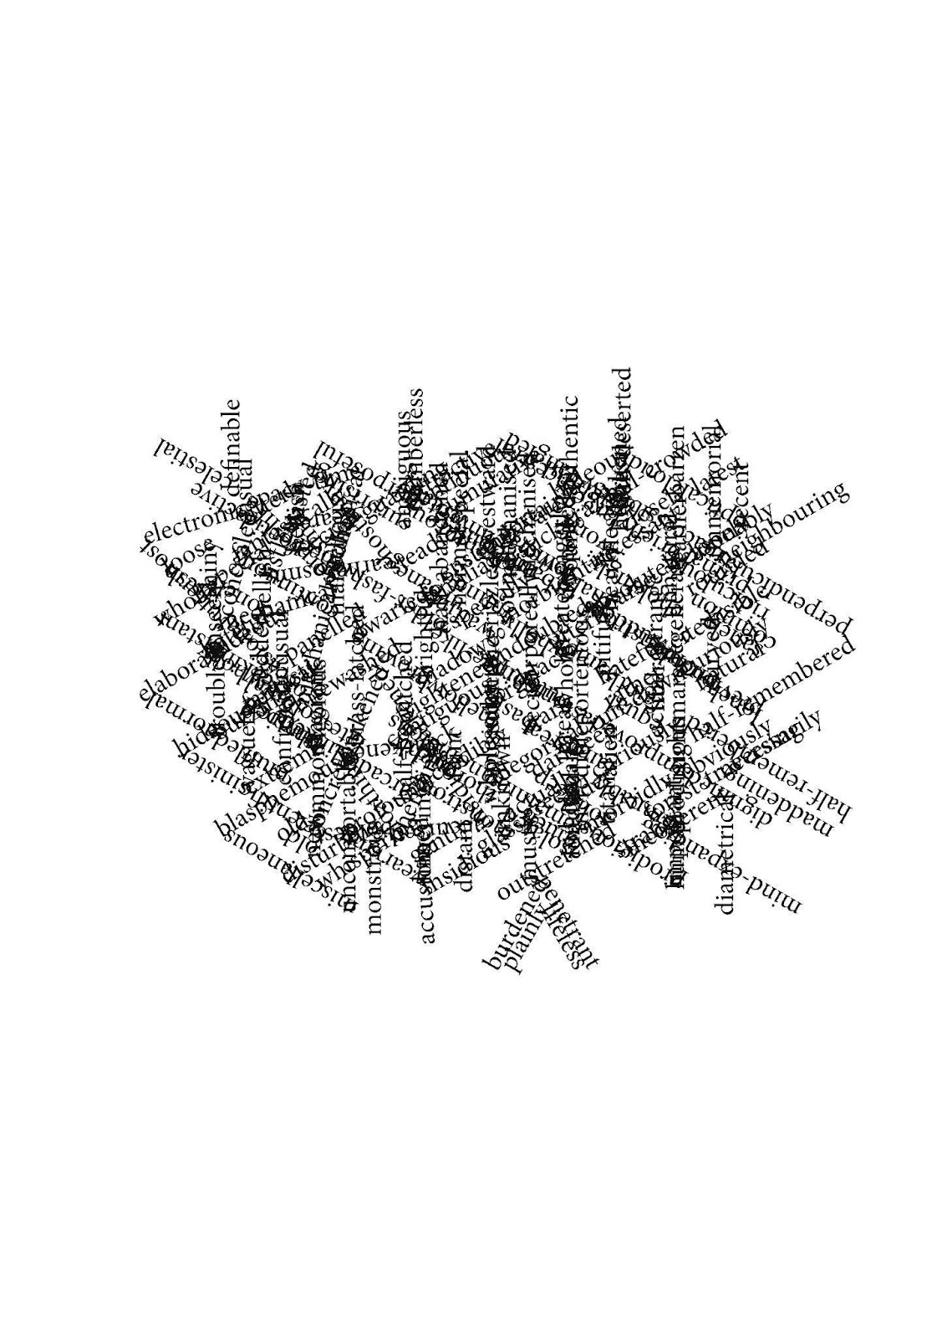
Notes:
The unpredictable results of the tool leave the edges jagged, creating a more threatening yet fragile feel, while certain words are exposed as accidental poems. Everything here balances on burdened, plainly, lifeless and penetrant, for example, while, on the left, an elaborate, blasphemous and hideous are shot into the shape.
The city of Arkham is the central landmark in Lovecraft country, appearing throughout his stories as a stepping stone into otherworldly territory. It’s the city by which many of his protagonists navigate themselves and the world around them.
I envision Arkham as the epitome of the Lovecraftian universe, peopled by white male literary professors and scientists, preferably with an aristocratic English heritage. In this pocket of time, Lovecraft can be safe.
But Arkham cannot stay that way and Lovecraft’s sanctuary deserves a détournement, hence the title, Maps to Arkham. These poems, and the landscapes they embody, envision an alternative capital of Lovecraft country, each one approaching but never spawning the actual city. They are a guide which churns up the soil and sky and leaves the pieces hanging. Anything whole is fragmented, and an unnatural order runs through the architecture of the page. It’s a place that can only ever exist on the page, distorted beyond legibility and ever-shifting in a process of horrifying instability.
Lovecraft hates this collection. He haunts it through necessity, but would otherwise take pleasure in seeing it destroyed. It’s thanks to works like this that nobody reads poetry anymore. What’s worse, his words are the very building blocks of this architectural mess. This collection is a labyrinth, each poem pushing Lovecraft further from his comfort zone. His writing has turned on him and is eating its own kingdom, word by word, paragraph by paragraph, and legend by legend.

Slide 13
Maps to Arkham
Nat1 (publisher): Prepare to embark on an extraordinary voyage through the enigmatic realm of H.P. Lovecraft’s Arkham in this innovative chapbook. Crafted through a unique blend of artistic expression and technology, this daring work introduces readers to a captivating fusion of maps—concrete poems created by Lovecraft's texts—and fragments of original poetry. This isn't your typical homage to Lovecraft; it's a profound investigation into the mysteries surrounding his most infamous fictional city. While it offers insights into the city's mythos, it also fearlessly challenges and satirizes the legacy of the renowned writer. Rather than celebrating Lovecraft, this exceptional sequence of poems delves into his idiosyncrasies, unconventional love life, and career failures, shedding new light on his persona and the world he created. Maps to Arkham is a must-read for anyone intrigued by Lovecraftian lore and those who crave a fresh perspective on the enigmatic author himself.
Essay in Writing in Practice, volume 9 (2023)

